Slide 1


Week 5 Presentation
Mar. 18, 2015
Justin Wang
Mehak Bhatua
Victor Ye
Xiao Xu
Yifan Tang

Slide 2
Project Timeline (2/11/15 – 4/24/15)
Feb
Mar
Apr
W0
W1
W2
W3
W4
W5
W6
W7
W8
W9
W10
Domain Studies
Identify 3rd party
Domain list
IP Studies
Identify CDNs
Categorize
Performance Studies
Time lag
Summarize

Slide 3
Methods Capability
Dataset | Size | Unique ID# | With IP | Methods
 |  |  |  | R | Tableau | Excel
#1 | 14 MB | 762 | No
#2 | 1 GB | 4098 | No
#3 | 14 GB | Crashed | Yes
#4 | 1 GB | 3240 | Yes
Excellent
Good
Satisfactory
Poor
Very poor

Slide 4
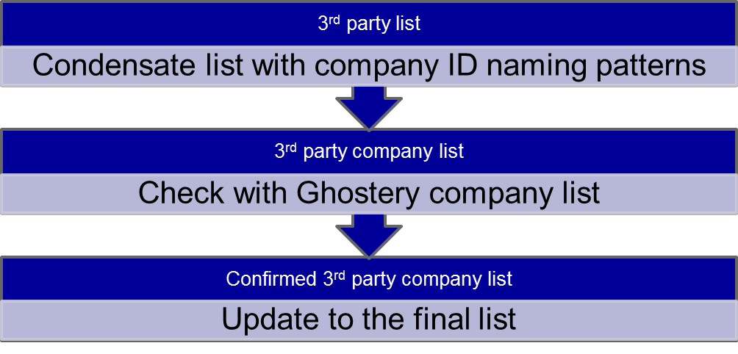
Unique ID List Building Process
Full List
Remove 1st party

Slide 5
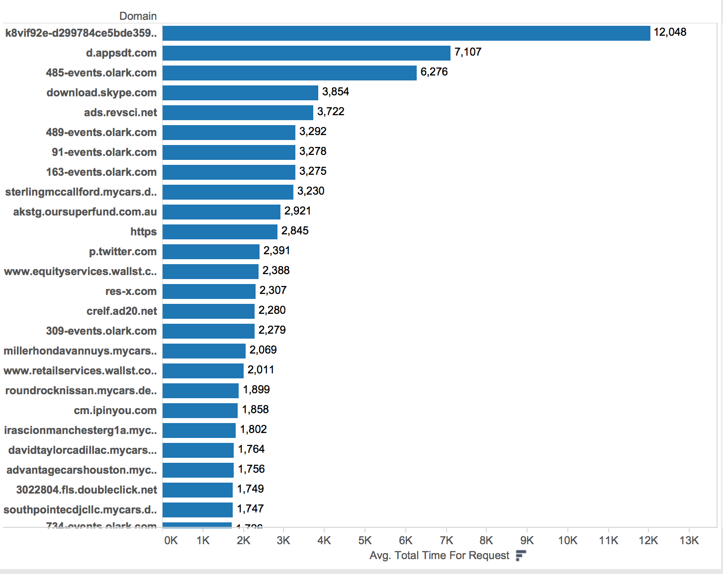
Performance Analysis
Lag Time > (ms) | Unique Domain#
0 | 3231
100 | 2058
200 | 1269
300 | 701
400 | 428
500 | 327
600 | 279
700 | 231
800 | 200
900 | 176
1000 | 152

Slide 6

THANK YOU!

Slide 7
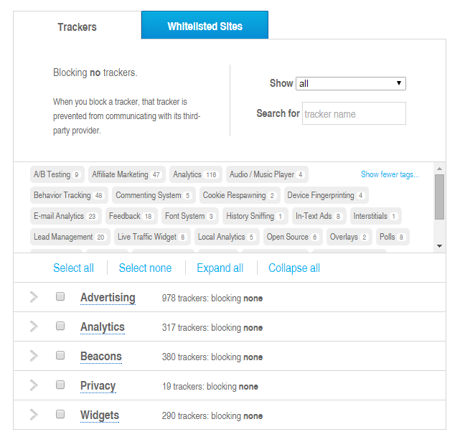

Ghostery Company List

Slide 8
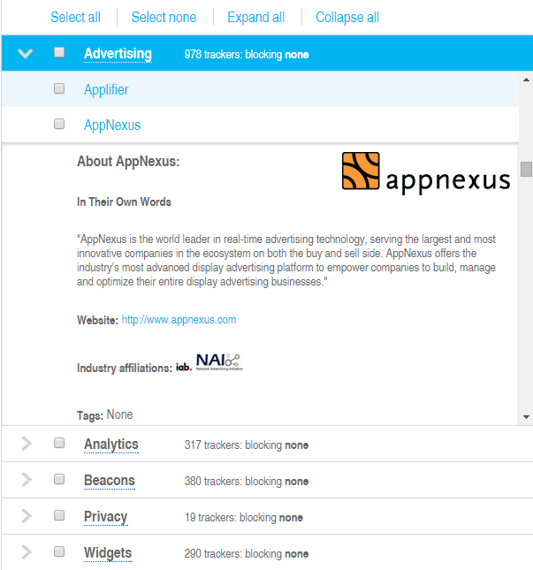
Ghostery Company List

